Slide 1
Lec - 6

Slide 2
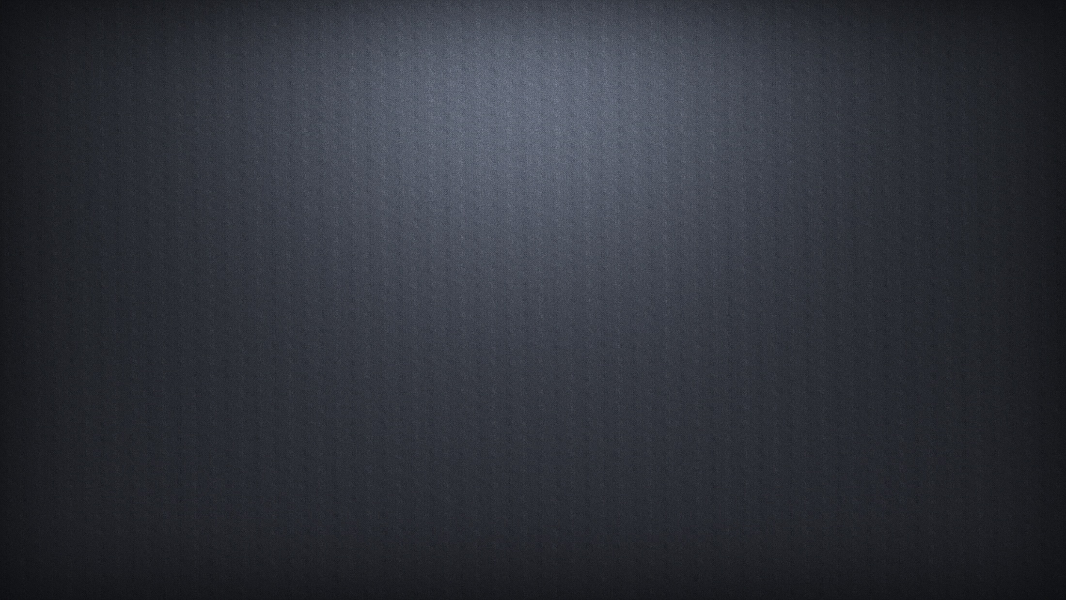
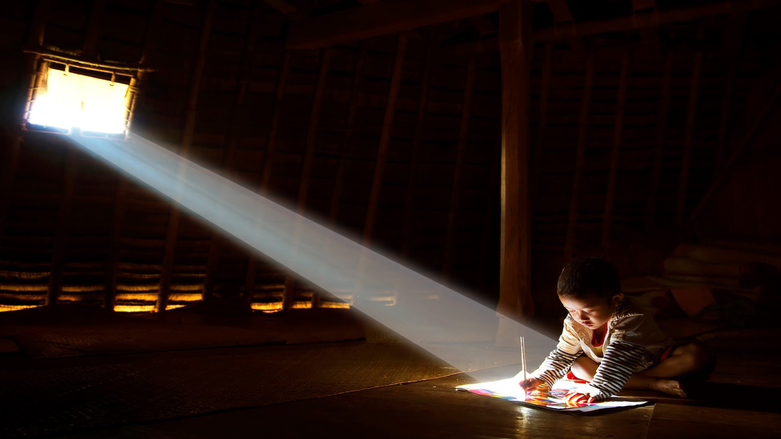
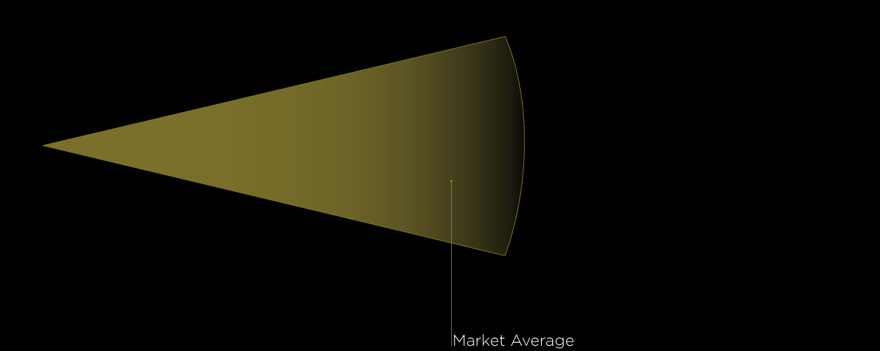


LIGHT
LIGHT
Light is travelling
in a straight line
Light is a form of ENERGY that produces the sensation of vision.
Rectilinear Propagation
Reflection of light
P
i = r
incident ray
angle of incidence
i
Q
Normal
r
angle of reflection
reflected ray
R
Opaque Surface

Slide 3


P
REFRACTION OF LIGHT
Incident ray
Normal
Change in the direction of propagation of a ray of light, when it travels obliquely from one medium to another transparent medium, is called refraction of light.
i
(rarer)
A
air
B
Q
glass
(denser)
r
Refracted ray
Rarer to Denser: towards normal
glass
D
air
Denser to Rarer: away from normal
R
C
e
S
Emergent ray

Slide 4
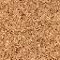


Let us understand why does the ray of light bend?
CONCLUSION
Tractor bends towards the normal as its velocity decreases.
Speed is more
L
Light bends towards the normal as its velocity decreases.
R
Speed is less

Slide 5
Let us understand why does the ray of light bend?
CONCLUSION
Rarer to denser → towards the normal
Denser to rarer → away from the normal
Light travels straight → No deviation
Speed is same
R
L

Slide 6

What happens when
DENSER TO RARER
ALONG THE NORMAL
RARER TO DENSER
Normal
Normal
i
i
Water
(or glass)
Air
Water
(or glass)
Air
r
r
It bends towards the normal
It bends away from the normal
It passes undeviated.
Velocity Decreases
Velocity increases
Velocity decreases

Slide 7
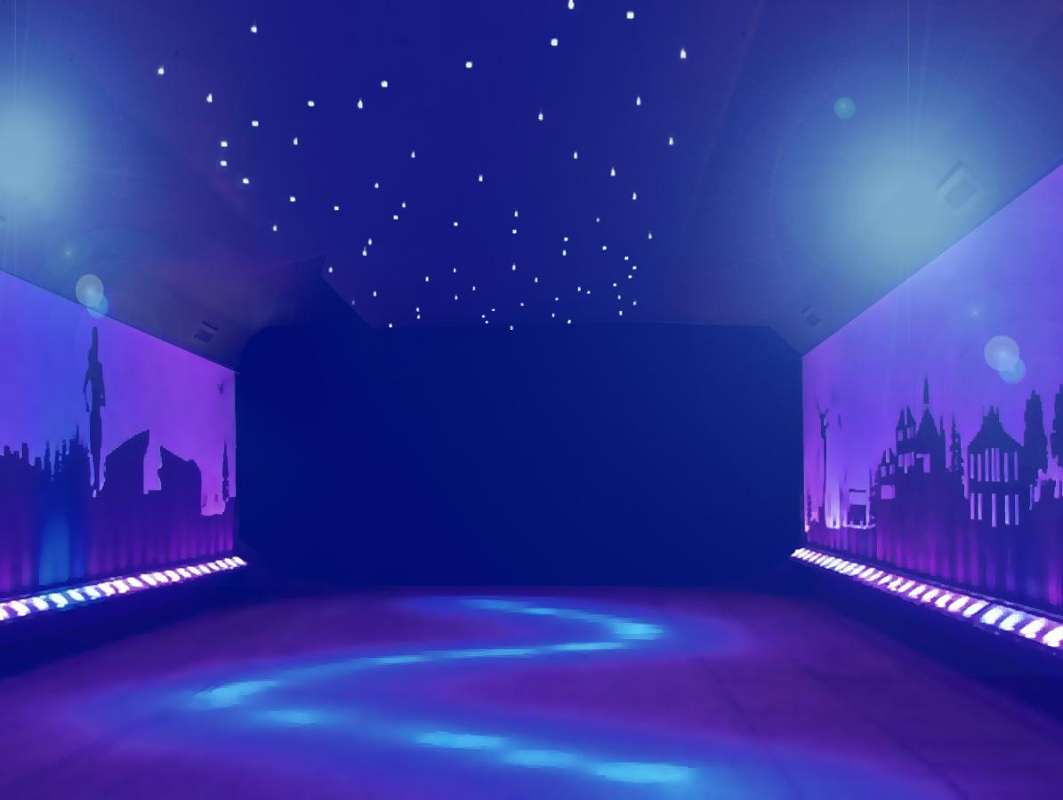

QUIZ TIME QUIZ TIME QUIZ TIME QUIZ TIME QUIZ TIME QUIZ TIME QUIZ TIME QUIZ TIME QUIZ TIME QUIZ TIME QUIZ TIME QUIZ TIME QUIZ TIME QUIZ TIME QUIZ TIME QUIZ TIME QUIZ TIME QUIZ TIME QUIZ TIME
QUIZ TIME QUIZ TIME QUIZ TIME QUIZ TIME QUIZ TIME QUIZ TIME QUIZ TIME QUIZ TIME QUIZ TIME QUIZ TIME QUIZ TIME QUIZ TIME QUIZ TIME QUIZ TIME QUIZ TIME QUIZ TIME QUIZ TIME QUIZ TIME QUIZ TIME

Slide 8

ALL THE BEST !!

Slide 9
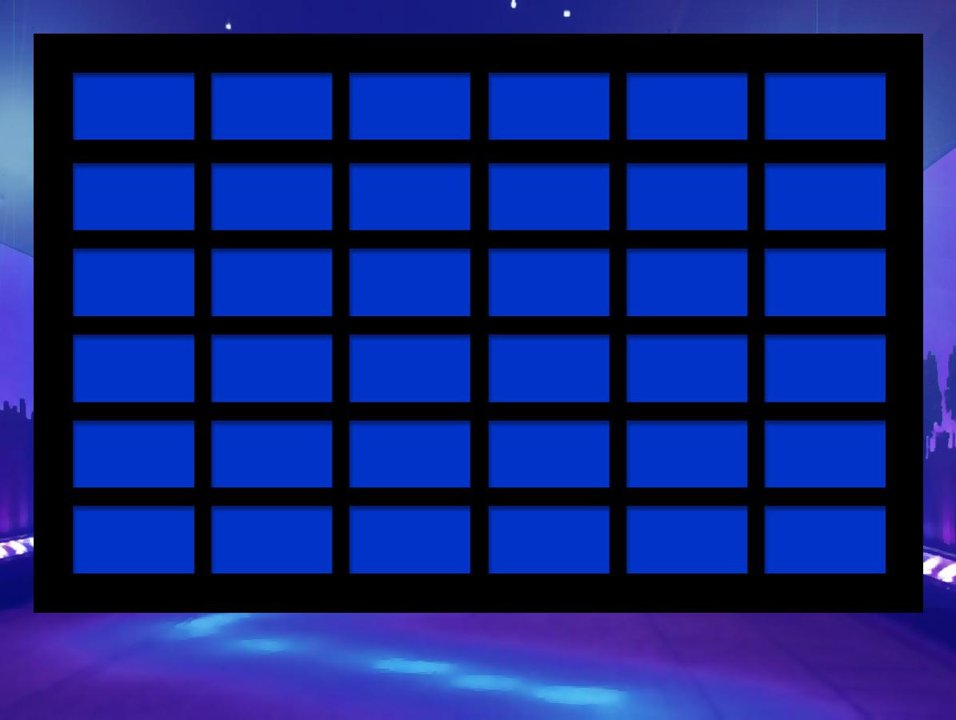
1
2
3
4
5
6
7
8
FINAL QUIZ TIME

Slide 10
If a ray of light strikes the glass slab at 30°. What is the angle of incidence?
(A) ∠i = 30°
(C) ∠i = 40°
(B) ∠i = 60°
(D) ∠i = 0°

Slide 11
If a ray of light strikes the glass slab at 30°. What is the angle of incidence?
(A) ∠i = 30°
(C) ∠i = 40°
(B) ∠i = 60°
(D) ∠i = 0°

Slide 12
If a ray of light strikes the glass slab normally. What is the angle of incidence?
(A) ∠i = 30°
(C) ∠i = 40°
(B) ∠i = 60°
(D) ∠i = 0°

Slide 13
If a ray of light strikes the glass slab normally. What is the angle of incidence?
(A) ∠i = 30°
(C) ∠i = 40°
(B) ∠i = 60°
(D) ∠i = 0°

Slide 14
If a ray of light strikes the glass slab at 30°. What is the angle of emergence?
(A) ∠e = 30°
(C) ∠e = 60°
(B) ∠e = 40°
(D) ∠e = 0°

Slide 15
If a ray of light strikes the glass slab at 30°. What is the angle of emergence?
(A) ∠e = 30°
(C) ∠e = 60°
(B) ∠e = 40°
(D) ∠e = 0°

Slide 16

FREE POINT

Slide 17
A ray of light strikes a glass slab at an angle of 50º with the normal to the surface of the slab. What is the angle of incidence?
(A) 50°
(C) 40°
(B) 25°
(D) 100°

Slide 18
A ray of light strikes a glass slab at an angle of 50º with the normal to the surface of the slab. What is the angle of incidence?
(A) 50°
(C) 40°
(B) 25°
(D) 100°

Slide 19
A ray of light gets deviated when it passes obliquely from one medium to another medium because ____________
(A) colour of light changes
(C) speed of light changes
(B) frequency of light changes
(D) intensity of light changes

Slide 20
A ray of light gets deviated when it passes obliquely from one medium to another medium because ____________
(A) colour of light changes
(C) speed of light changes
(B) frequency of light changes
(D) intensity of light changes

Slide 21
FREE POINT

Slide 22
Rakesh performs the experiment of tracing the path of a ray of light passing through a rectangular glass slab for different angles of incidence. He observes that in all cases __________.
(A) ∠i > ∠r but ∠i = ∠e
(C) ∠i > ∠e but ∠i = ∠r
(B) ∠i < ∠r but ∠i = ∠e
(D) ∠i < ∠e but ∠i = ∠r

Slide 23
Rakesh performs the experiment of tracing the path of a ray of light passing through a rectangular glass slab for different angles of incidence. He observes that in all cases __________.
(A) ∠i > ∠r but ∠i = ∠e
(C) ∠i > ∠e but ∠i = ∠r
(B) ∠i < ∠r but ∠i = ∠e
(D) ∠i < ∠e but ∠i = ∠r

Slide 24
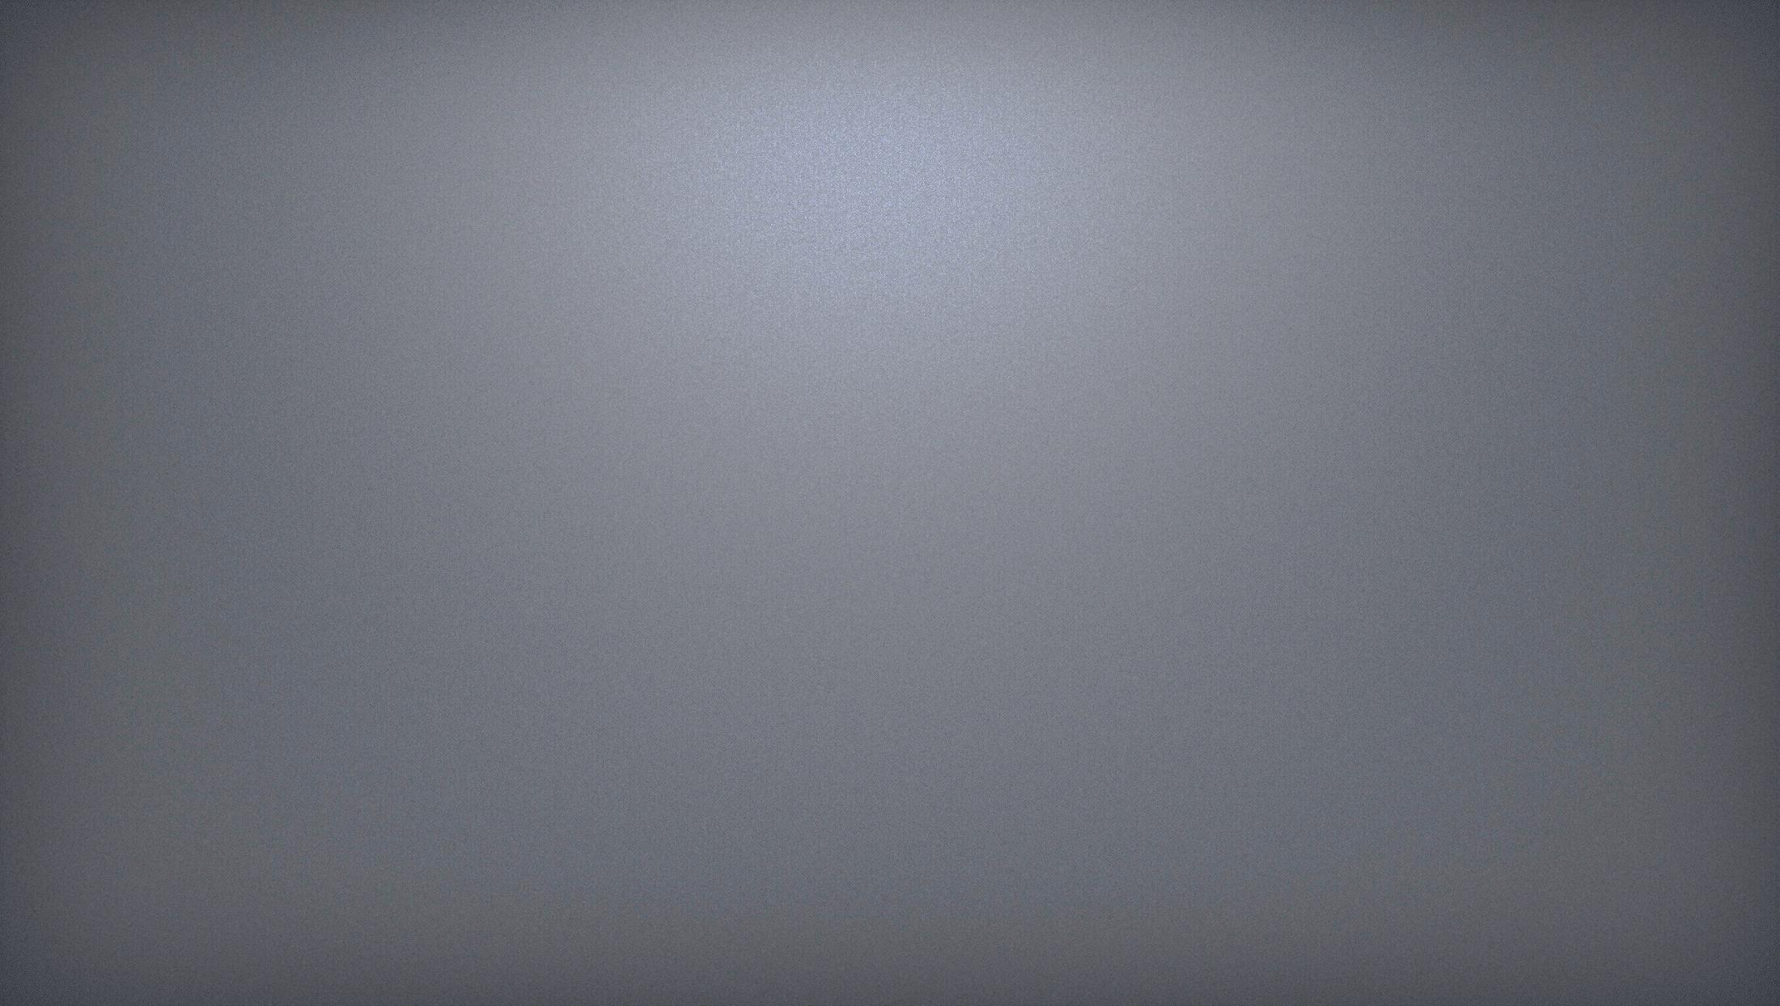
REFRACTION OF LIGHT
P
Incident ray
Change in the direction of propagation of a ray of light, when it travels obliquely from one medium to another transparent medium, is called refraction of light.
Laws of Refraction
Normal
i
(rarer)
1. The incident ray , the refracted ray and the normal to the interface of two transparent media at the point of incidence, all lie in the same plane.
A
air
B
Q
glass
(denser)
r
2. The ratio of the sine of angle of incidence to the sine of the angle of refraction is a constant, for the light of a given colour and for the given pair of media. This law is also know as Snell’s law of refraction.
Refracted ray
D
R
C
sin i
Refractive
index (n)
= constant
sin r

Slide 25
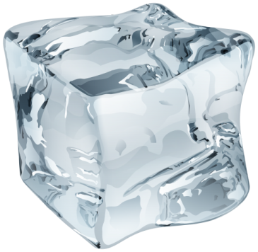
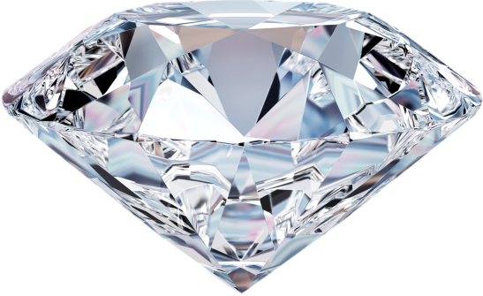
REFRACTION OF LIGHT
P
Incident ray
Change in the direction of propagation of a ray of light, when it travels obliquely from one medium to another transparent medium, is called refraction of light.
ICE
DIAMOND
Laws of Refraction
Normal
i
(rarer)
2.42
1. The incident ray , the refracted ray and the normal to the interface of two transparent media at the point of incidence, all lie in the same plane.
A
air
B
Q
glass
(denser)
r
2. The ratio of the sine of angle of incidence to the sine of the angle of refraction is a constant, for the light of a given colour and for the given pair of media. This law is also know as Snell’s law of refraction.
Refracted ray
D
R
C
sin i
sin i
= 1.31
= 2.42
sin i
Refractive
index (n)
sin r
sin r
= constant
sin r

Slide 26


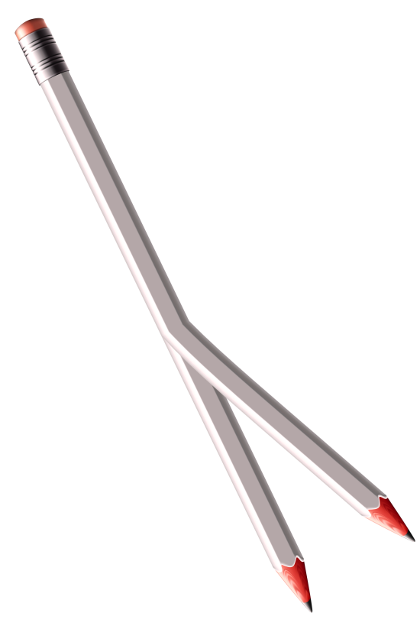
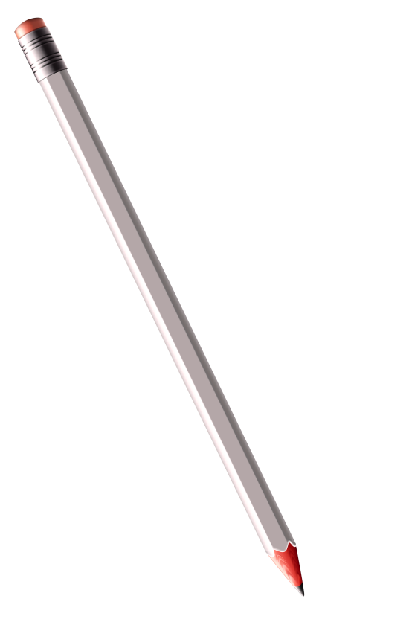
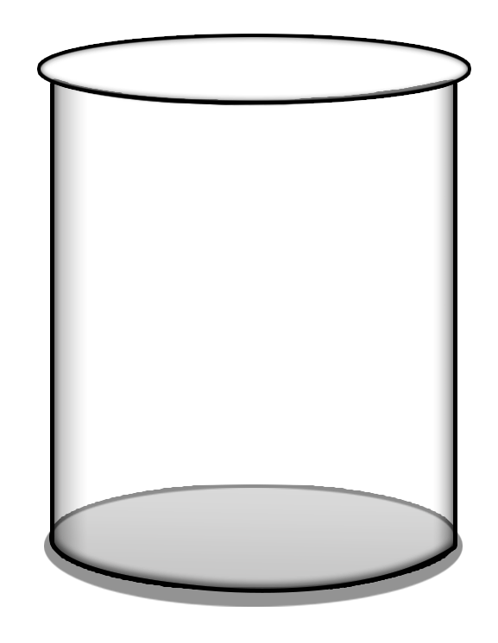

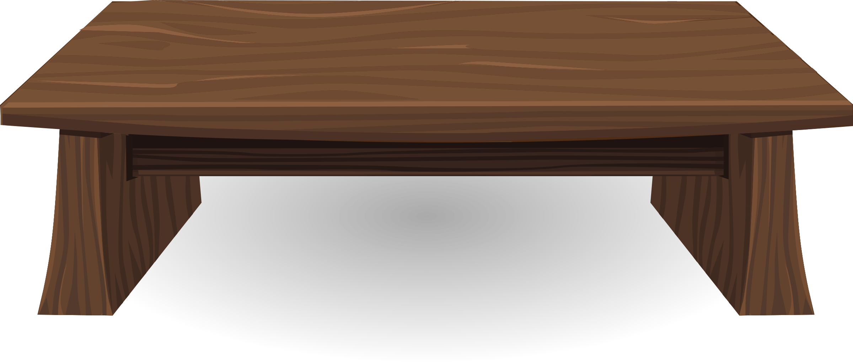
Pencil appears to be broken in a beaker with water
THUS, BECAUSE OF THE REFRACTION OF LIGHT COMING FROM THE PART OF THE PENCIL THAT IS UNDER WATER, THE PENCIL APPEAR BEND.
Apparent Position
Actual position

Slide 27

REFRACTIVE INDEX
P
We know that
normal
n
incident ray
sin i
₂
i
₁
(rarer)
=
Refractive Index
sin r
air
Medium 1
n
V₁
Medium 2
glass
₁
₁
₂
Q
₂
=
(denser)
V₂
Reciprocal of each other
r
n
V₂
₁
₁
₂
₂
=
V₁
refracted ray
n
1
₂
=
n₁₂
₁
R

Slide 28


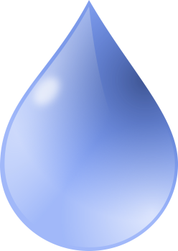
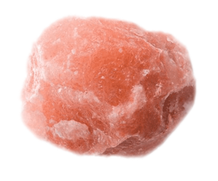

Absolute refractive index of some material media
1.0003
1.31
1.33
Vacuum
Vacuum
Absolute refractive index means 1st medium is vacuum
Vacuum
Air
ICE
Water
1.52
1.54
2.42
Absolute refractive index of Air is 1.0003
Absolute refractive index of Ice is 1.31
Absolute refractive index of water is 1.33
Vacuum
Vacuum
Vacuum
Conclusion:
Refractive index increases, the bending capacity increases
Diamond
Crown glass
Absolute refractive index of Rock salt is 1.54
Absolute refractive index of diamond is 2.42
Absolute refractive index of Crown glass is 1.52
Rock salt

Slide 29
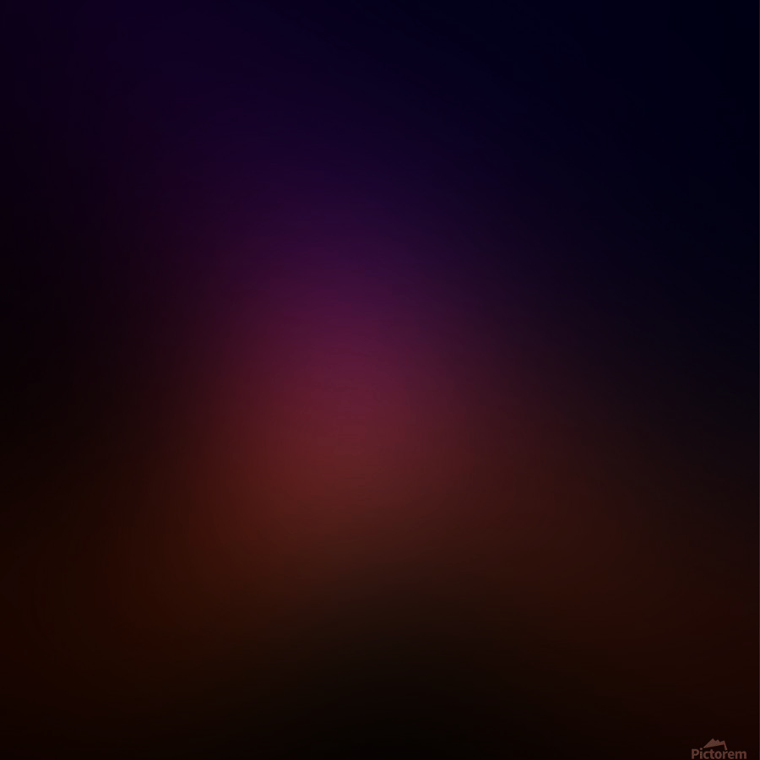
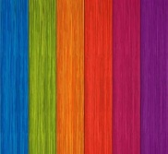
Q.
The refractive index of diamond is 2.42. What is the meaning of this statement?
Ans.
The refractive index of diamond 2.42 suggests that, the speed of light in diamond will reduce by a factor 2.42 as compared to its speed in air.

Slide 30

FRAMING THE FORMULA FOR REFRACTIVE INDEX
n
V
v
a v
=
Absolute Refractive index of air
V
a
n
V
a
=
Refractive index of ice w.r.t the air
ice a
V
ice
n
V
v
=
Absolute Refractive index of glass
g v
V
g
n
V
a
w a
=
Refractive index of water w.r.t the air
V
w
n
V
a
=
oil a
Refractive index of oil w.r.t the air
V
oil

Slide 31
FORMULAE
n₂₁
V₁
n₂₁
1
1.
2.
=
=
n₁₂
V₂
V₁ = velocity of light in 1st medium
V₂ = velocity of light in 2nd medium
Important Points
1
If the first medium is not mentioned, take 1st medium as Air
2
If the first medium is Vacuum then refractive index of 2nd medium is called as Absolute refractive index
3
For solving Numerical, Velocity of light in air = Velocity of light in vacuum = 3 × 10⁸ m/s
n = Refractive index has no units

Slide 32
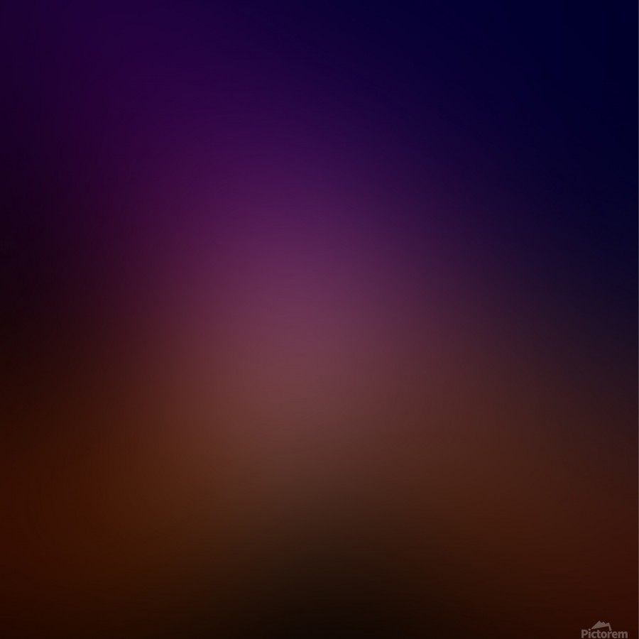
1
Light enters into a glass plate having absolute refractive index 1.50. What is the speed of light in glass? ( The speed of light in vacuum is 3 × 10⁸ ms⁻¹)
Given :
Velocity of light in vacuum (V_{v})
= 3 × 10⁸ m/s
Absolute refractive index of glass (η_{gv})
= 1.50
To Find :
Velocity of light in glass (V_{g})
= ?
η_{gv}
V_{v}
Formula :
=
V_{g}
η_{gv}
V_{v}
Solution :
=
V_{g}
V_{v}
∴
V_{g}
=
η_{gv}
3 × 10⁸
∴
V_{g}
=
1.50
The speed of light in glass is 2 × 10⁸ m/s
V_{g}
= 2 × 10⁸ m/s

Slide 33
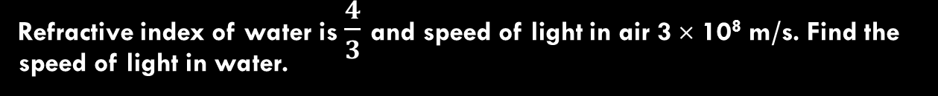
2
Refractive index of water is $\frac{4}{3}$ and speed of light in air 3 × 10⁸ m/s. Find the speed of light in water.
Given :
(η_{wa})
4
Refractive index of water
=
3
Speed of light in air (v_{a})
= 3 × 10⁸ m/s
To Find :
Speed of light in water (V_{w}) = ?
η_{wa} =
V_{a}
Formula :
V_{w}
4
3 × 10⁸
Solution :
=
3
V_{w}
3 × 10⁸ × 3
V_{w}
=
4
V_{w}
=
9 × 10⁸
v_{w}
The speed of light in water is 2.25 × 10⁸ m/s
= 2.25 × 10⁸ m/s
4

Slide 34
3
If the refractive index of water for light going from air to water is 1.33, then what will be the refractive index for light going from water to air?
Given :
(η_{wa})
Refractive index of water w.r.t. air
= 1.33
To Find :
Refractive index of air w.r.t. water (η_{aw}) = ?
η_{aw} =
1
Formula :
η_{wa}
η_{aw} =
1
Solution :
η_{wa}
η_{aw} =
1
1.33
η_{aw} = 0.75
Refractive index of air w.r.t. water (η_{aw}) is 0.75

Slide 35
4
The refractive index of kerosene, turpentine and water are 1.44, 1.47 and 1.33, respectively. In which of these materials does light travel fastest?
Speed of light in air
Solution :
Refractive index =
Speed of light in medium
Speed of light in air
Speed of light in medium =
Refractive index
It is obvious from the above relation that the speed of light will be the maximum in that medium which has the lowest refractive index.
Now out of kerosene, turpentine and water, water has the lowest refractive index of 1.33.
So, the light will have maximum speed in water or light will travel fastest in water.

Slide 36
In which of the given media, light moves the fastest ?
Medium Refractive index
Water 1.33
Ice 1.31
Alcohol 1.36
(ii) Using above table, calculate the velocity of light in water.
Q.
Ans.
(i) Light travels fastest through ice which has the lowest refractive index.
Velocity of light in air
(ii) Velocity of light in water =
Refractive index of water
3 ×10⁸ ms^{–1}
=
1.33
= 2.25 × 10⁸ ms^{–1}

Slide 37
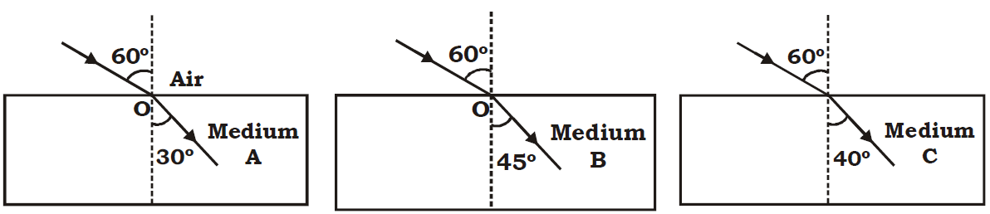
(a) The path of light passing from air to different media A, B, and C for a given angle of incidence is shown below. Study the diagrams and answer the following questions.
Q.
(i) Which of the media A, B and C has maximum optical density ?
(ii) Through which of three media, will the speed of light be maximum ?
(iii) Will the light travelling from A to B bend towards or away from the normal ?
Ans.
(a) (i) sin 30º < sin40º < sin45º ⇒ ηA > ηC > ηB
∴Medium A has maximum optical density.
(ii) Speed of light will be maximum in the medium B of lowest refractive index ηB.
(iii) As ηA > ηB, light travelling from A to B will bend away from the normal

Slide 38
Thank You

